Slide 1
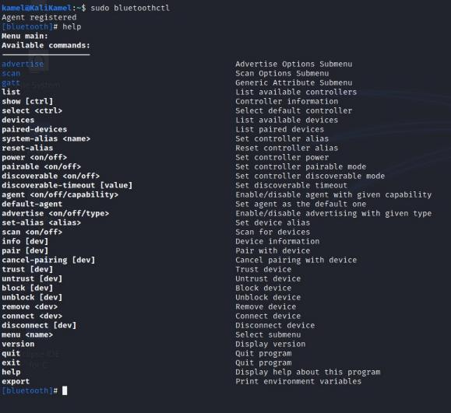
1. Getting Started
Bluetooth Security Hands-on Exercises – Slides 1-17
Follow the lab manual to log into your virtual
machine and connect your Bluetooth adapter!
To begin the hands-on portion of this training, we’ll start with connecting to our training platforms and configuring our Bluetooth adapter
We’ll start off by making sure our BT adapter is on and running a page scan and an inquiry scan to see nearby devices.

Slide 2
2. Bluetooth Scanning
A good first step for any type of security assessment is searching for nearby devices
We know that we have a target device in our area. The first thing we have to do is find that device
USB
Scanning for BT devices in our proximity will let us find the target device and it’s BT address
VM

Slide 3
2. Bluetooth Scanning
Scanning for BT devices will show you devices in your area that are discoverable
Modern devices are usually non-discoverable by default, unless you are connecting/pairing with a new device
USB
Our device has intentionally been put into
discoverable mode for this training
VM

Slide 4
2. Bluetooth Scanning
Follow along through step 3 of your Lab Manual
You should be able to detect the target device (and some of your fellow students)
USB
Be sure to note the target device’s BT address!
You’ll be using it a lot
VM

Slide 5
A Note on BT Addresses and Scanning
Bluetooth Address
48-bit “unique” value
AA:BB:CC:DD:EE:FF
First 3 Bytes: Organizationally Unique Identifier (OUI)
  First 2: Non-significant. address Part
  Third: Upper Address Part
Last 3 Bytes: Lower Address Part
Normally invisible unless discoverable
*OUI =/= Chip manufacturer!

Slide 6
3. Enumerating Bluetooth Information
Now we’ve found the BT address of the target device. This is how we’ll address our information requests to it
We want to learn as much as possible about our target over Bluetooth
INFO?
The “info” tool in the “hcitool” suite is a good
start for this

Slide 7
3. Enumerating Bluetooth Information
Follow along with your Lab Manual through step
4. Take note of the different types of information you can see
Keep in mind, all of this information is obtained before any pairing or authentication with the target
INFO?
We just need to know its BT address

Slide 8
3. Enumerating Bluetooth Information
Something to take note of: The information obtained in this step is mostly information about the Bluetooth adapter itself
There isn’t much information as to what that adapter is doing on the device it resides in
INFO?
The next step will give us some more info
regarding what it’s hoping to do

Slide 9
4. Identifying BT Services
BT is used for lots of different applications. What applications an individual BT device is configured to support can be discovered using the Service Discovery Protocol
SDP is a special BT protocol – it’s meant to let devices learn about how they can interact with one another
SDP
As a result, SDP information is often shared without encryption or authentication
SERVICES

Slide 10
4. Identifying BT Services
When you want to learn what BT services are in use by a target device, checking its SDP server is a good first step
It can be seen as a “port scan” of a BT device
SDP
Follow your Lab Manual through step 5 to get
some data from the target device’s SDP server
SERVICES

Slide 11
5. Analyzing SDP Output
Depending on how complex the target is, the
SDP server may give you a lot of data
We’ve added a special service to this device for
the purpose of this training
SDP
This service will be a target for you to send data to and perform other tests
SERVICES

Slide 12
5. Analyzing SDP Output
Analyze the data you received from the SDP server
You’ll need to know the RFCOMM channel in use by the custom service to be able to send data to it
SDP
There’s also a few hints in the SDP data of the custom service that you may want to keep track of
SERVICES
Proceed through part 6 of your Lab Manual

Slide 13
6. Pairing Devices In Linux
We’ve found the target service hosted on the device, and now we want to get started interacting with it
The target service is designed not to interact with other devices unless it is paired with that device, however
We’ll use the hints we found in previous steps and the tools available in Linux to pair with the target device

Slide 14
6. Pairing Devices In Linux
There are two general forms of pairing – Legacy Pairing and Secure Simple Pairing (SSP)
SSP is the more secure version by far, but our target is configured to use legacy pairing for this training
Older devices that only supported legacy pairing would use a PIN code to pair. On some devices, this was a manufacturer-set default code like 0000 or 1234

Slide 15
6. Pairing Devices In Linux
Once we’ve paired to the target device we can
send data to the target service
You can attempt to send data without pairing, but it wont’ be accepted! Pairing and connecting with devices are two separate concepts
Follow your Lab Manual through step 7 to complete the pairing process.
This might need a few attempts with so many people pairing at once*

Slide 16
7. Sending Data Over Bluetooth
Now that we’ve paired with the target device, it’s time to finish up the CTF
We’ve set up the target service to accept text data sent over BT to the target service’s RFCOMM channel
Key 1
There are two flags to find:
The first one is hidden in the information you can see
with the tools you’ve learned
The second will be revealed when you successfully send the first key to the target service
Key 2

Slide 17
7. Sending Data Over Bluetooth
Sending data over BT is not very hard, but we’ve developed a custom helper script for you to make it easier
~/Training_Scripts/2CHVBT_Helper.py (or something like that)
Find the first key hidden in the data you can read – following the clues we left
Key 1
Key 2
Once you’ve found it, follow the steps in your Lab Manual to use the helper script and find the second key!

